Slide 1


Mind Management Skills Workshops
Social Comparisons
The unhelpful effects of comparing ourselves to others and how to stop

Slide 2
Housekeeping
Today’s workshop will run for 90 minutes and is designed to be interactive – we encourage participation
Confidentiality – we encourage participation, especially considering the content of this group. However, you are not expected to share anything that you do not want to, anything disclosed will be kept confidential within the group – please see confidentiality rules for further information
Please be respectful of other group members who may choose to share their experiences – maintain the confidentiality of the group

Slide 3
Further Support
The workshops are designed to be skills-focussed, rather than problem-centred. However, if any of today’s discussion or exercises cause you to experience distress, you may wish to pursue further support
Full details can be found in the supporting information you received before this workshop
  Accessing the Student Health and Wellbeing Service
  Listening services such as the Nightline and the Samaritans
  How to access evidence-based therapy through the NHS

Slide 4
Questionnaire

Slide 5
What is CBT?
An evidence-based talking therapy
A way of understanding the relationship between our thoughts, emotions, physiology and behaviour
A therapy that provides a range of coping strategies or techniques that can influence these patterns
  Some of which we will be discussing later in this workshop

Slide 6
Goals for today
To learn about the effects of social comparisons using the “CBT model”
To notice the links between our thoughts, feelings, physiology and behaviour and how comparisons can cause “vicious cycles”
To learn about the role of our attention when feeling anxious in social situations
To practice ways of breaking vicious cycles through changing our attention, thoughts and behaviours

Slide 7
Why social comparisons?
We ran a series of focus groups with undergraduate students to find out what they experienced as common difficulties in student life
Making social comparisons was reported as one of the most common problems students struggled with
We want to provide workshops to help UG students learn ways of reducing unhelpful comparisons and the distress they can cause

Slide 8
Why social comparisons?
The temptation to compare ourselves to others is normal
And the opportunities to do so are frequent!
Role models
Siblings
Influencers
Housemates
Work colleagues
Ourselves
Friends from school
Course mates
People we don’t like
Celebrities

Slide 9
Vicious Cycles in CBT
Trigger
Thoughts
Behaviour
Emotions
Physical

Slide 10
Hearing a course mate talk about how much of the extra reading they have done
Thoughts: “they have done so much more than me, I haven’t got a clue… They are much more intelligent than me – they’re bound to get a first and I’d be lucky to scrape a 2:2”
Behaviour: leave the building, go back home, put off starting work, turn on the TV
Emotions: jealous, panicked, hopeless, dread
Physical: tense, hot, knot in stomach

Slide 11
Seeing a group of people in Freshers’ week laughing and hugging on a pub crawl
Thoughts: “They’re so much cooler than me, they’ve already made loads of friends… why can’t I be that relaxed? No one will want to talk to me like this”
Behaviour: avoid eye contact, keep to myself, buy a drink and stand in the corner
Emotions: miserable, jealous, apprehensive
Physical: tense, lethargic, heavy

Slide 12
Exercise – the vicious cycle
Use handout 1
Either individually or if comfortable, in pairs or threes
Bring to mind a recent example of a time you compared yourself to someone else
Choose an example that is not too distressing and that you are comfortable reflecting on in this group
Complete the handout:
  What situation were you in?
  What went through your mind?
  How did you feel?
  What did you do?
  How do these things connect?

Slide 13
The power of “noticing”
Making a comparison, and noticing that you are having thoughts can be very different experiences
Noticing can help you to step back and reflect on what your mind is doing, rather than being embroiled in unhelpful thoughts
  Becoming aware of the thought
  Experiencing it less intensely
  Being aware of it without engaging fully in it
  Seeing it for what it is – an event in your mind, rather than an objective fact
  This can allow us to respond differently to our vicious cycles
Psychological Therapies Training and Research Clinic; School of Psychology

Slide 14


The River
Psychological Therapies Training and Research Clinic; School of Psychology

Slide 15
The role of our attention
When we feel anxious in social situations, it is very common for our minds to focus on what we are worrying about
This usually means having an internal focus of attention
  Fixating on our body for signs of anxiety
  Focussing on worrying thoughts
Internally-focussed attention can stop us from noticing our surroundings and finding out what is actually going on
It also makes us more likely to notice sensations in our body that wouldn’t have otherwise bothered us

Slide 16
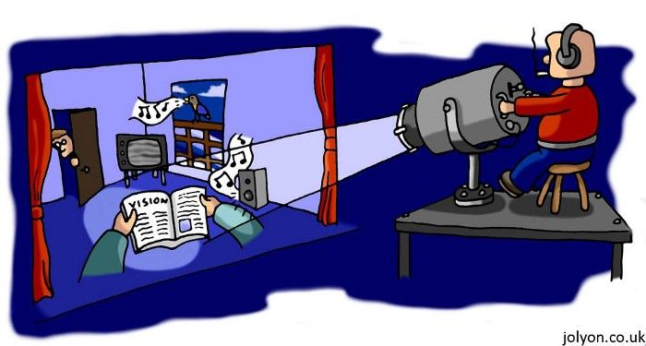
The role of our attention

Slide 17
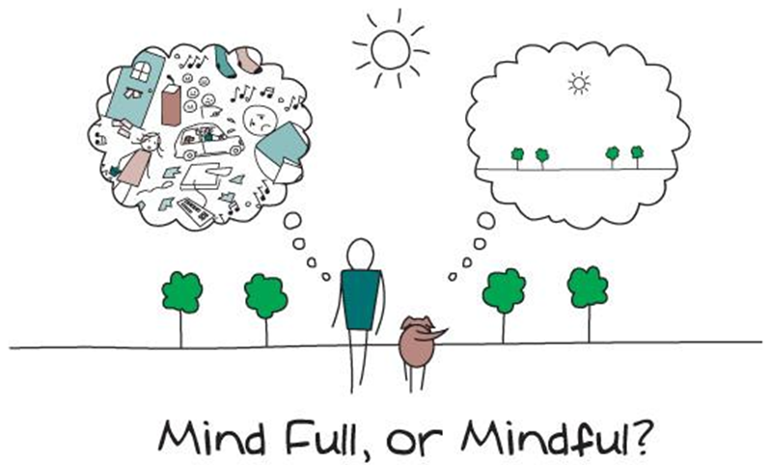
The role of our attention
Source of image: https://coachcampus.com

Slide 18
Attention and the vicious cycle
Seeing a group of people in Freshers’ week laughing and hugging on a pub crawl
Thoughts: “They’re so much cooler than me, they’ve already made loads of friends… why can’t I be that relaxed? No one will want to talk to me when I look this awkward”
Physical: tense, tremors, hot
Emotions: nervous
Behaviour: head down, focus on how I am standing, posture, try to look relaxed

Slide 19
Exercise – changing the focus of attention
As a group, take 60 seconds and with eyes closed, focus all of your attention on your body and pay close attention to any sensations going on inside it
Then, take 60 seconds and tune your attention to your surroundings, listen to any sounds going on around you
If your mind wanders, just gently bring it back to the task

Slide 20
Feedback
What difference did changing the focus of attention make?
What did you notice?
What insight does this offer for what our minds do when comparing ourselves to others?
How could we influence our attention in a new way during these situations?
Where can our mind be placed?

Slide 21
Unhelpful Thought Patterns
Mental Filter – When we notice only what the filter allows or wants us to notice, and we dismiss anything that doesn’t ‘fit’. I.e. when we think we are stupid, we look for evidence to support it
Prediction – Believing we know what the outcome of something will be or what will happen in the future. I.e. I will fail
Mind-Reading – Assuming we know what others are thinking (usually about us) i.e. they don’t like me
Critical self – Putting ourselves down, self-criticism, blaming ourselves for events that are not entirely our responsibility
Should’s and musts – Thinking ‘I should’ (‘or shouldn’t’) and I must.. i.e. I must put pressure on myself to meet expectations
Judgements – Making evaluations or judgments about events, ourselves or others rather than describing what we may have evidence for
Emotional Reasoning – I feel bad so it must be bad i.e. I feel anxious so something bad is about to happen
Mountains and Molehills – Exaggerating the risk of danger or the negatives and minimising positives or how likely things will be to turn out
Catastrophising – Imagining and believing that the worst thing will happen
Black and white thinking – Believing that things or ourselves are good or bad, right or wrong with no in-between or middle ground
Memories – Current situations and events can trigger upsetting memories, leading us to believe that it is happening again which can cause distress

Slide 22
Unhelpful Thought Patterns
Mental Filter – When we notice only what the filter allows or wants us to notice, and we dismiss anything that doesn’t ‘fit’. I.e. when we think we are stupid, we look for evidence to support it
Prediction – Believing we know what the outcome of something will be or what will happen in the future. I.e. I will fail
Mind-Reading – Assuming we know what others are thinking (usually about us) i.e. they don’t like me
Critical self – Putting ourselves down, self-criticism, blaming ourselves for events that are not entirely our responsibility
Should’s and musts – Thinking ‘I should’ (‘or shouldn’t’) and I must.. i.e. I must put pressure on myself to meet expectations
Judgements – Making evaluations or judgments about events, ourselves or others rather than describing what we may have evidence for
Emotional Reasoning – I feel bad so it must be bad i.e. I feel anxious so something bad is about to happen
Mountains and Molehills – Exaggerating the risk of danger or the negatives and minimising positives or how likely things will be to turn out
Catastrophising – Imagining and believing that the worst thing will happen
Black and white thinking – Believing that things or ourselves are good or bad, right or wrong with no in-between or middle ground
Memories – Current situations and events can trigger upsetting memories, leading us to believe that it is happening again which can cause distress

Slide 23
Exercise
Take a few minutes to reflect on the previous slide
Are there any unhelpful thought patterns that you can relate to?
Any in particular that you notice yourself doing often, particularly when comparing yourself to other people?
When making social comparisons, what impact might these patterns have?
Being aware of your most common patterns will help you notice them sooner

Slide 24
The effect of social media

Slide 25
The effect of social media
We live in a world where current technology provides unprecedented glimpses and insight into the lives of others
“Always online” lifestyle
People create representations of themselves online – the persona they want the world to see
  Facebook, Instagram, Tiktok…
These representations are rarely truly reflective of who they actually are…
What effect does having 24/7 access to these online profiles have on our temptation to make comparisons…?
…and what effect do these comparisons have on how we feel?

Slide 26
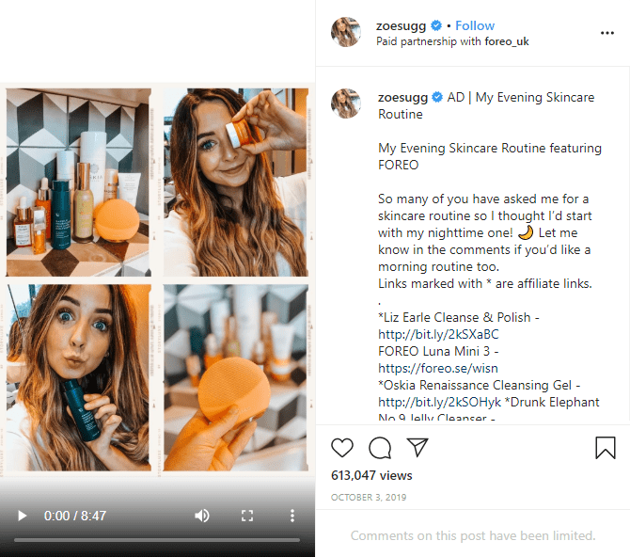

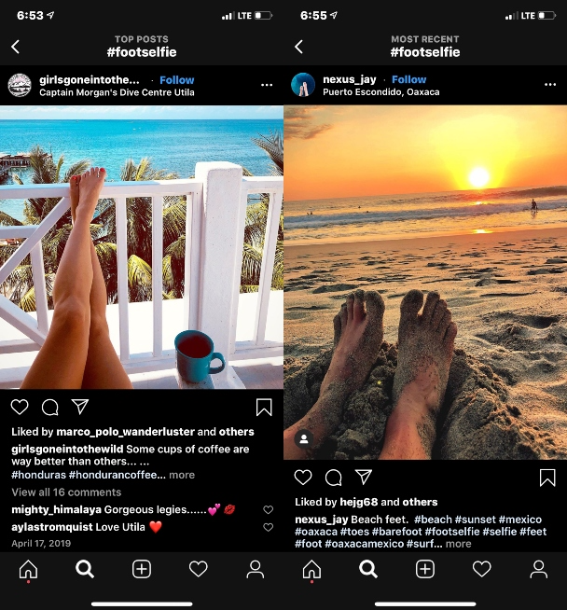
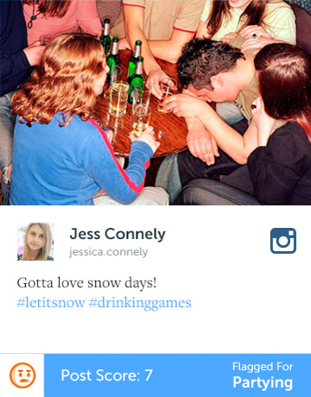

Notes:
z

Slide 27
What hooks us in?
Curiosity?
Fear of missing out?
Excitement?
We all experience some feeling that “hooks us in” and reinforces the behaviour of checking and comparing on social media

Slide 28
What are the consequences?
Loneliness
Self-criticism
Body image insecurities
Anxiety – on edge
Low mood/de-motivation
Lack of engagement

Slide 29
Tips to consider
Be aware of the reasons behind your use of social media
  What is the purpose of me checking?
Be aware of how much time you are spending online
Ask yourself – how is this behaviour making me feel right now?
  Is it having a positive or negative impact on my mood?
  Is it helpful or unhelpful?
  What could I do instead of it?
Consider “rationing” your use of social media if it feels out of control
Agreeing how long to spend on it, when to put it down, what to do to replace it

Slide 30
Learning to respond helpfully
So far we have explored the CBT model and learned about the role of our attention and unhelpful thought patterns in maintaining our distress
We have discussed the importance of noticing when we are in these patterns
Having noticed, let’s now take some time to think about ways of responding to or influencing these patterns
Getting out of the cycle

Slide 31
Attention and the vicious cycle
Seeing a group of people in Freshers’ week laughing and hugging on a pub crawl
Exit?
Thoughts: “They’re so much cooler than me, they’ve already made loads of friends… why can’t I be that relaxed? No one will want to talk to me when I look this awkward”
Physical: tense, tremors, hot
Emotions: nervous
Behaviour: head down, focus on how I am standing, posture, try to look relaxed
Exit?

Slide 32
Thoughts: is this an unhelpful thought pattern? Are these thoughts accurate? What would I say to someone else in my shoes right now?
Respond: stay out of the content of my thought, let the thought pass, engage in a more accurate or balanced thought instead
Social comparison/vicious cycle
Notice: what thoughts am I having? Where is my attention?
Greater engagement in the current situation
Attention: where is my attention right now? What is it I am focussed on? What am I not noticing? Where could I place my attention instead?
Respond: choose where to place my attention externally, focus more on the situation and what is happening in it, less on me and my thoughts

Slide 33
Exercise – learning to respond helpfully
Either individually or if comfortable, in pairs or threes
Using your vicious cycle example from the earlier exercise and handout 2
Bring to mind the experience, what the comparison was and where your attention was focussed
Ask the questions in handout 2
Plan a more helpful response to the unhelpful thoughts
Work out where you could place your attention in the situation to learn or engage more

Slide 34
Key Messages
Social comparisons can cause vicious cycles:
  The way we think affects how we feel and what we do
  What we do will affect the way we think and how we feel
Our attention and unhelpful thought patterns can play a key role in how distressing social comparisons can be
Learning to notice and reflect on the interactions between our thoughts, feelings and behaviours helps us work out how to break out of these cycles
  Responding helpfully to unhelpful thought patterns
  Placing our attention externally

Slide 35
Homework
Practice the skills from today’s workshop
Using your handouts, throughout the week use the blank vicious cycle diagrams to record your thoughts, feelings and behaviours when you notice you are making social comparisons
  Label your thoughts with a possible unhelpful pattern type
  Notice when your attention is too internally focussed
  Identify helpful responses in these moments
Try to complete the exercises live, in the moment your thoughts, feelings and behaviours are occurring

Slide 36
Thank you

